Slide 1

Congestion Management
India-California Air-Pollution Mitigation Program (ICAMP)
Initiative for Air Mitigating Pollution from the Transportation Sector
Dr.Kayitha Ravinder & Dr Errampalli Madhu
Principal Scientist
CSIR-Central Road Research Institute
New Delhi-25
5th February 2014

Slide 2
Presentation Outline
Introduction
Overview of the Congestion Mitigation Measures
Congestion Mitigation measures feasibility/ relevance to Indian (Delhi) conditions
Conclusions

Slide 3
Introduction- Vehicle Growth (India)
Vehicles plying on Indian roads increased from 55 million (2001) to 141 million (2011)
About 10% annual growth during 1991-2001,12% (2001-05) and16 to18% (2005-2011)

Slide 4
Introduction- Vehicle Growth (India)
Total Number of Registered Vehicles
Maharashtra-17.4 m,
Tamil Nadu-15.6 m,
UP-13.3 m,
Gujarat-13.0 m,
AP-10.2 m,
Karnataka-9.9 m
Almost 50% of vehicles in Six States

Slide 5
Introduction- Vehicle Growth (India)
Delhi is at top with about 7 million followed by Bangalore, Chennai and Hyderabad
Delhi ≈ 2*Bangalore
Delhi ≈ 2*Chennai
Delhi > 2*Hyderabad
Delhi ≈ Bangalore+Chennai
Delhi >Mumbai+Chennai+Kolkata
Total Number of Registered Vehicles in Million Plus Population Cities in India (2011)

Slide 6
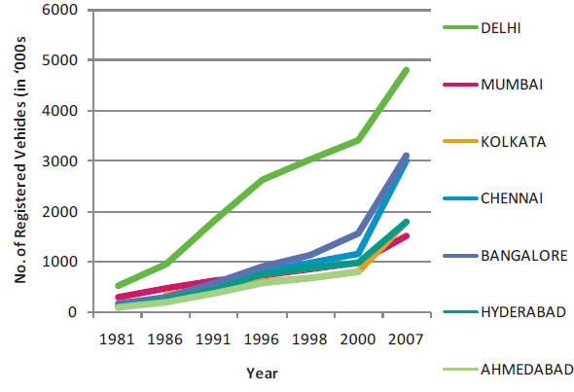
Introduction - Vehicle Growth
(Major Cities in India)
*
*7,496,190 (Sept 2012)
11% of metropolitan cities population having 32% Vehicle registration
Out 32% vehicles 13% of vehicles concentrated in Delhi, Mumbai, Kolkata & Chennai
53.5 % in Delhi and rest 46.5% in (Mumbai, Kolkata & Chennai)

Slide 7
Introduction- Vehicle Growth (India)
Almost 9% Heavy Duty Vehicles (Buses, HCVs and LCVs)
Composition of Total Number of Registered Vehicles in India (2011)

Slide 8
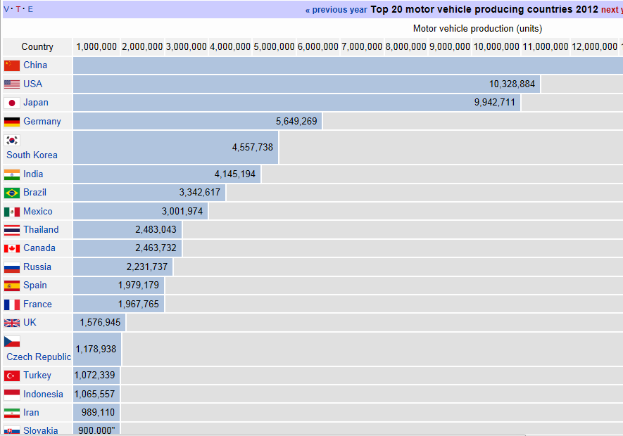
Introduction-Vehicle Production
19,271,808
India is sixth largest vehicle/car manufacturing industry in the world.

Slide 9
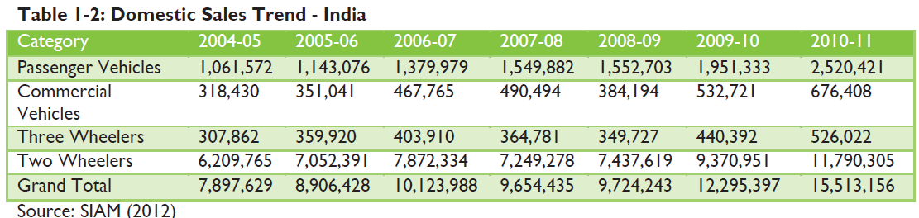
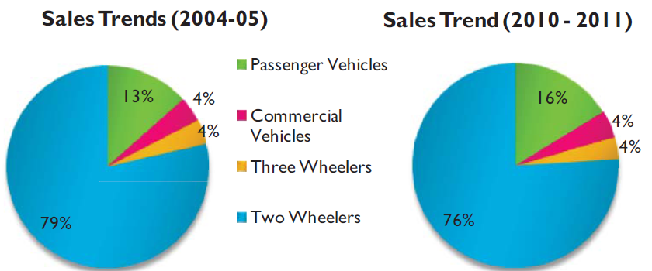
Domestic Vehicle Sale Trends in India
Two wheelers constitute more than 75% of the total registered vehicles
Cars sales share has increased from 13% (2004-05) to 16% (2010-11)
Two wheeler sales share has decreased from 79% (2004-05) to 76% (2010-11)

Slide 10
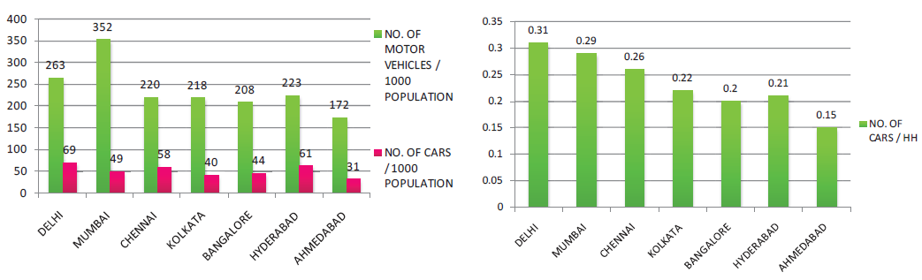
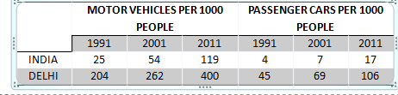
Car Ownership in Mega Cities in India
2001
Car modal share is between 30-40% of the total traffic in mega-cities, the vehicle share of car is only 8-14%
% of cars is increasing, the peak hour journey speed is decreasing
Comparing it with public transport, it constitutes about 10-20% of the
total traffic & its modal share is 30-55%.

Slide 11
Delhi Traffic Conditions

Slide 12

Summary of Traffic Volume Counts at Selected Mid-block Locations
Maximum Traffic Flow at ITO Bridge (Mid-block) 2.3 Lakh veh/day and NH-8 Toll Plaza (Outer Cordon) with 2.27 Lakh veh/day (3.27 Lakh/day in July 2013 with peak hour 25,000 vehicles/hr)
Summary of Traffic Volume Counts at Selected Intersections
Maximum Traffic Flow at Ashram Chowk with 3.65 Lakh veh/day (4.25 Lakh veh/day in 2013)

Slide 13
Typical Hourly Variation and Traffic Composition
Total Vehicles : 1,92,395/day
Lala Lajpath Rai Marg
Total Vehicles : 3,64,871 vehicles/day (1,35,173 v/d flyover traffic)
At Ashram Intersection

Slide 14
Comparison of Traffic Composition on Delhi Road Network (2009)
1992
2002
2009
Cars (with high) & Two Wheeler (with mild) grown (varies from 75-83%)
All others reduced

Slide 15
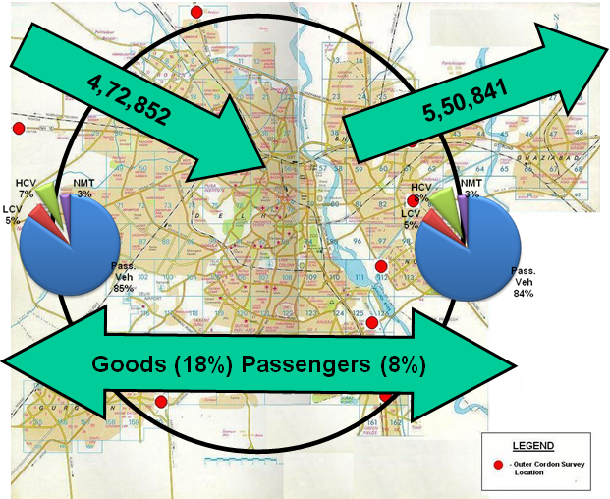
Pattern of External Traffic

Slide 16
Impacts of increasing Car Ownership Levels
Congestion
Air Pollution
Accidents
Car ownership increases as income increases
Car ownership rises with per-capita income even among the developed countries.

Slide 17
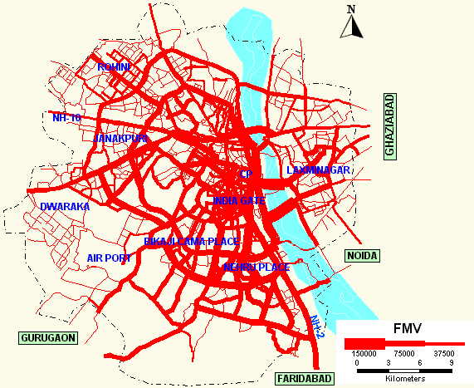

Traffic Flow Pattern in Delhi

Slide 18
Impacts of increasing Car Ownership Levels-Pollution
Vehicle Emission loads

Slide 19
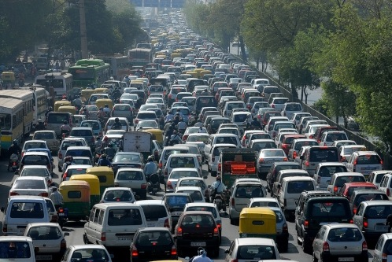
Impacts of Congestion in Delhi:
Capital get stuck in traffic snarls at least six times a month.
At least about 10.24 lakh vehicles daily entry/ exit into Delhi Road network ( CRRI 2009 study)
If all the vehicles plying on the Road is parked on Delhi roads. No space still vehicles exceeds the road space
According to 2009-10 CRRI study, on average 6 years will be lost in traffic Jams out of total 30 years of career

Slide 20
Estimated Traffic Load (VKT/day) on Delhi Road Network for the year 2010 and 2015
For any City to be sustainable ,..target is reduce ?????

Slide 21
Congestion Mitigation Measures

Slide 22
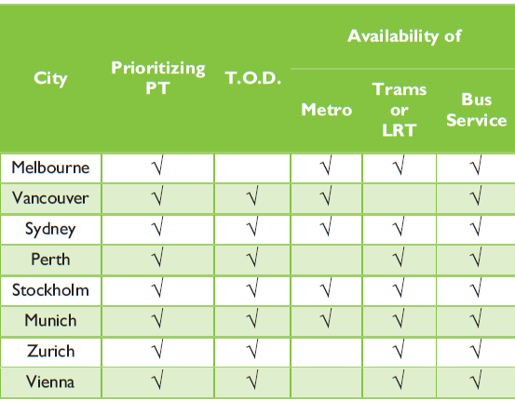
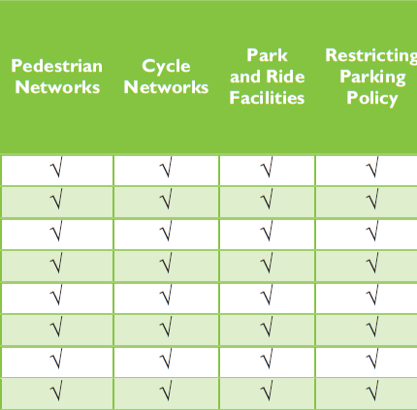
Transportation Systems of Some Cities

Slide 23
Various polices adopted world wide to reduce the Congestion
Policy /Measure | Country
Electronic Road Pricing/ Congestion Pricing | Congestion pricing to reduce the car usage in Central London,2003
 | Singapore – Road Pricing (Area Licensing Scheme)
 | Congestion pricing Seoul, South Korea,1996
Car Ownership Restrictions | Singapore - Vehicle Quota System
 | France – Rebates & Penalties for New Car Purchases based on Low & High CO₂ Emissions.

Slide 24
Various polices adopted world wide to reduce the Congestion
Policy /Measure | Country
Parking Restriction Measures | Seoul- Resident Parking Permit program, Garage Certification System, Parking Space Ceiling in Commercial Areas.
 | Parking Management in Kaiserslautern, Germany
 | Salzburg, Austria
 | Munich
Car –Pooling Schemes | Multi Stake holders Car Sharing in Fukuoka ( Japan)
Travel Plans | UK, NEW ZEALAND, JAPAN –Work Place Travel Plans, Household Travel Plans etc..

Slide 25
Various polices adopted world wide to reduce the Congestion
Policy /Measure | Country
Traffic Calming Measures | Walking street program in Bangkok, Thailand
 | Creation of Pedestrian Zones
Even & Odd Number of Car System | Seoul –Car Free days program

Slide 26
Various polices adopted world wide to reduce the Congestion
Policy /Measure | Country
Improving Public Transport & NMT Services | Walking Street Program in Bangkok, Thailand
 | Creation of Pedestrian Zones
 | Marikina Bikeways Network – Philippine City
 | Curitiba Integrating Transport Planning – Curitiba BRT
 | Beijing’s Integrated Road Transport Development –substituting for Private Travel
 | Urban Planning & Densifications Strategy for Reducing Car Use- Vancouver, Canada (2007)
 | BRT in Jakarta, Indonesia
 | Bus Pass Program –Michigan, USA
 | Van Transit System Bangkok, Thailand
 | BRT in Bogota, Columbia
 | Bus Service system in Bangalore

Slide 27
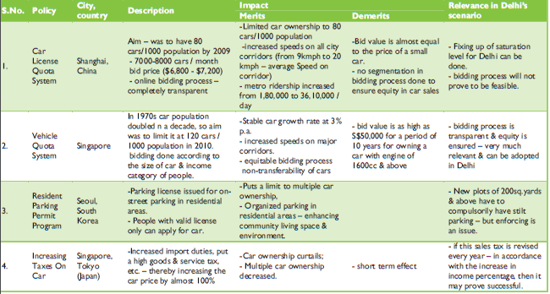
Summary of Best Practices for Congestion Mitigation Measures and their Relevance in Delhi’s Scenario
*
**
**
**

Slide 28
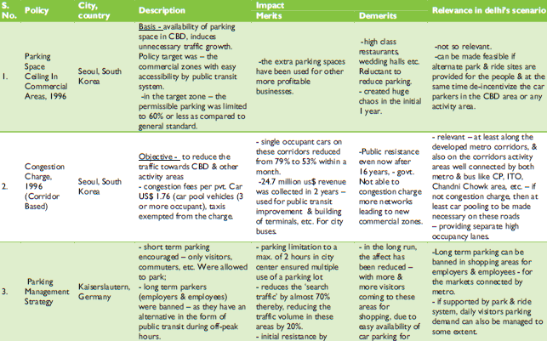
Summary of Best Practices for Congestion Mitigation Measures and their Relevance in Delhi’s Scenario
*
**
**

Slide 29
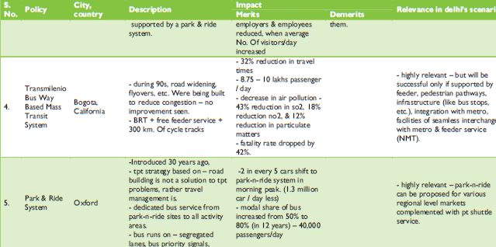
Summary of Best Practices for Congestion Mitigation Measures and their Relevance in Delhi’s Scenario
***
***

Slide 30
Expert Opinion Survey Results

Slide 31
Part-I: Car Ownership Restraint Measures
In the present traffic scenario of Delhi, do you recommend restricting?

Slide 32
Part-I: Car Ownership Restraint Measures (Continued..)
What are the major factors behind increasing car ownership in Delhi

Slide 33
Part-I: Car Ownership Restraint Measures (Continued..)
What are the de-merits of restraining car ownership?

Slide 34
Part-I: Car Ownership Restraint Measures (Continued..)
What policy options, should be adopted for restricting car ownership in Delhi. (Rate them in order of relevance to restrict car ownership in Delhi)
(Rating - 1 being least important & 5 being most important)

Slide 35
Part-I: Car Ownership Restraint Measures (Continued..)
What policy options, should be adopted for restricting car ownership in Delhi. (Rate them in order of feasibility to restrict car ownership in Delhi)
(Rating - 1 being not feasible in Delhi’s Scenario & 5 being highly feasible in Delhi’s Scenario)

Slide 36
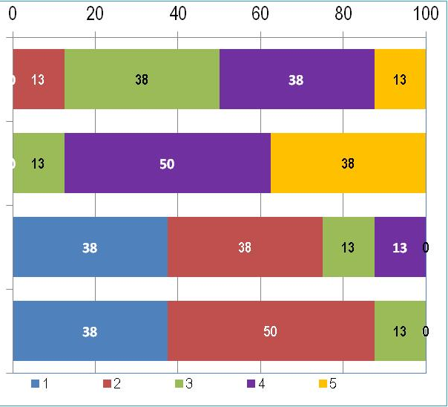
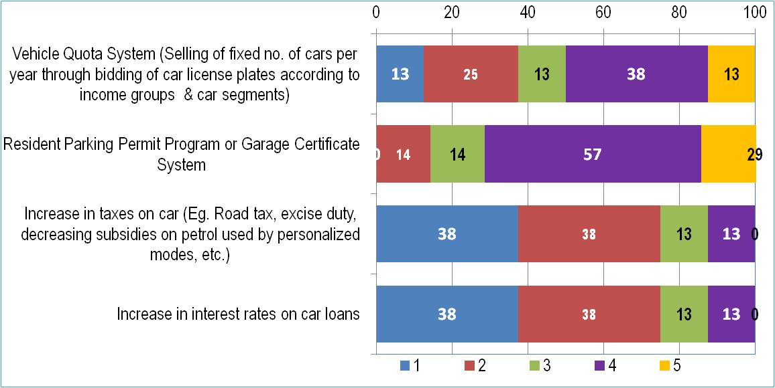
Car Ownership Restraint Measures (Continued..)
What policy options, should be adopted for restricting car ownership in Delhi?
Relevance
Feasible
√
√
(Rating - 1 being least important & 5 being most important)

Slide 37
PART II: Car Use Restraint Measures
What are the major factors behind increasing car usage? (Rate them in terms of their importance as a contributing factor to increasing car ownership)
(Rating - 1 being least important & 5 being most important)

Slide 38
Part-II: Car Use Restraint Measures (Contd..)
Which policy should be adopted for restricting car usage in Delhi. (Rate them in order of relevance to restrict car usage) - Relevance
(Rating - 1 being not relevant & 5 being very relevant)

Slide 39
Part-II: Car Use Restraint Measures (Contd..)
Which policy, should be adopted for restricting car usage in Delhi. (Rate them in order of relevance to restrict car usage) - Feasibility
(Rating - 1 being not feasible & 5 being highly feasible)

Slide 40
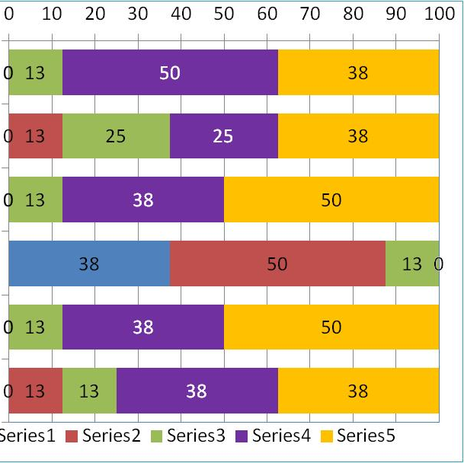
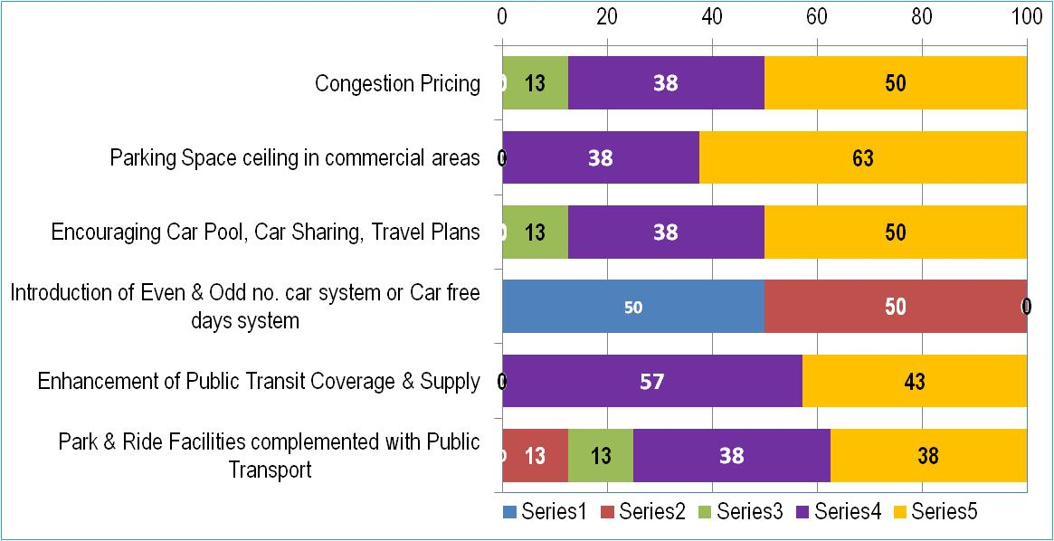
Part-II: Car Use Restraint Measures (Contd..)
Which policy, should be adopted for restricting car usage in Delhi. (Rate them in order of relevance to restrict car usage)
Relevance
Feasibility
√
√
√
X
√
√
(Rating - 1 being not feasible & 5 being highly feasible)

Slide 41
Part-II: Car Use Restraint Measures (Contd..)
Should congestion pricing be based on:

Slide 42
Part-II: Car Use Restraint Measures (Contd..)
What are the pre-requisites, for implementing congestion pricing?
(Rating - 1 being least important & 5 being most important)

Slide 43
Part-II: Car Use Restraint Measures (Contd..)
What should be threshold cost for congestion pricing?

Slide 44
Part-II : Car Use Restraint Measures (Contd..)
What is feasible to implement car pooling & travel plans strategy?

Slide 45
Conclusions
Vehicle Registration and Traffic is increasing rapidly at urban centers in India
Resulting in negative externalities Congestion, Air pollution, Accidents
Considering the Indian Socio-Economic and Polity Conditions. We should first attempt pilot study before we implement any policy
For the Indian Conditions we should attempt multi –policy oriented; only single policy do not work for sustainable transportation.

Slide 46
Thank You

Slide 47
Part-II : Car Use Restraint Measures (Contd..)
Regarding Parking fee which will be more effective?

